Slide 1
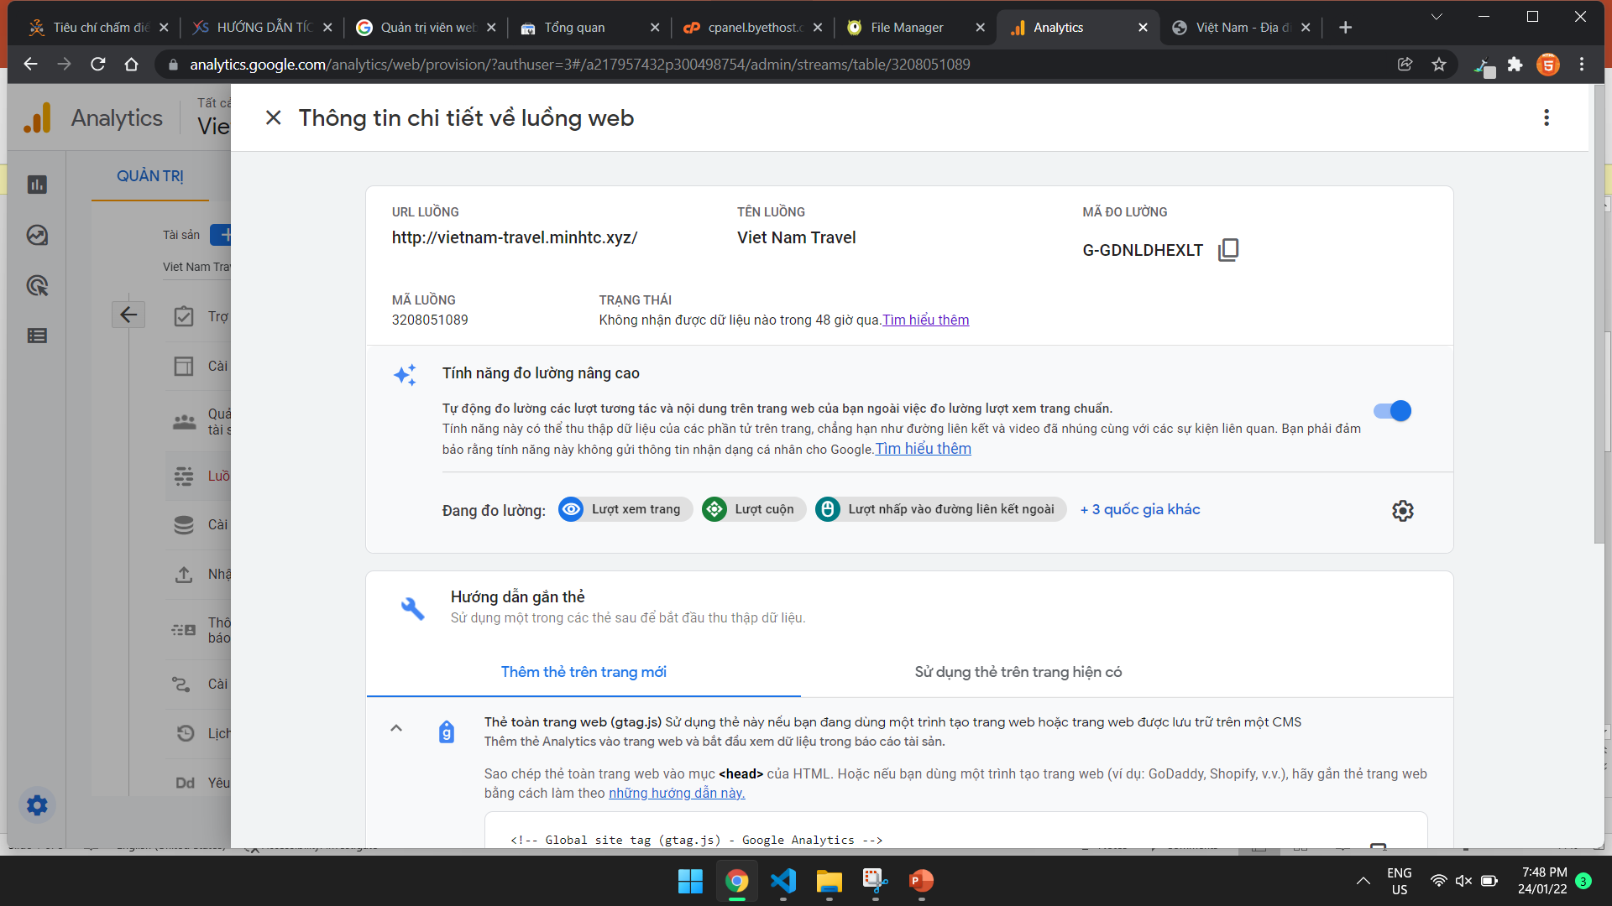

Slide 2
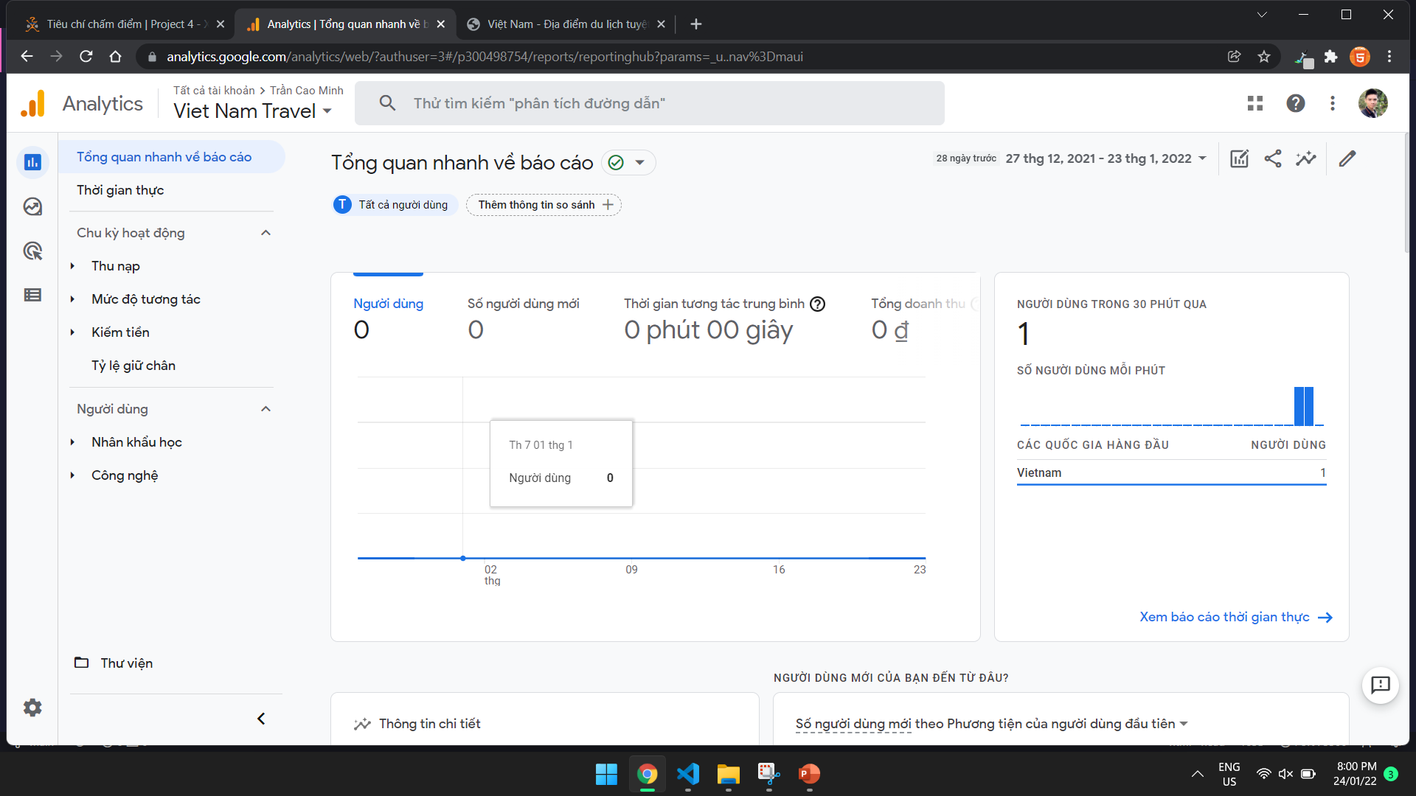

Slide 3
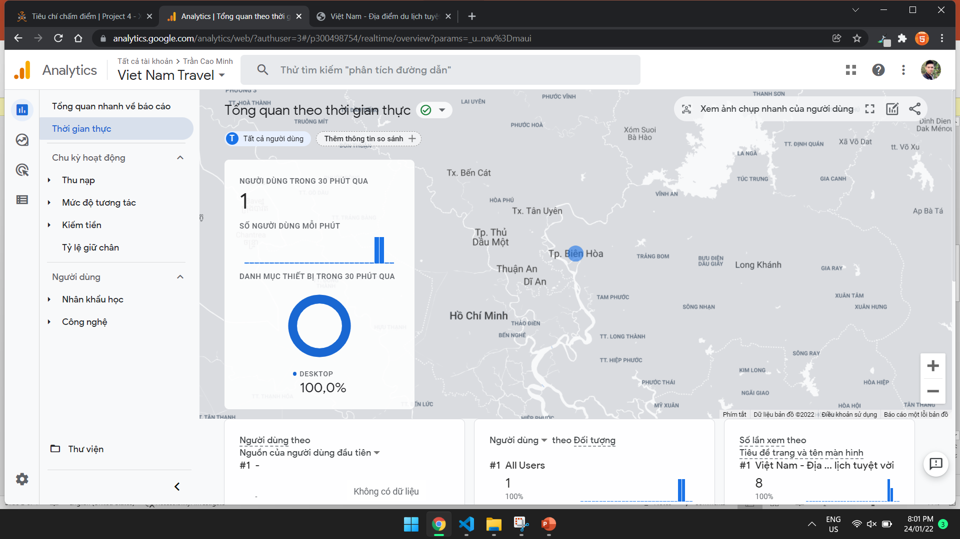

Slide 4
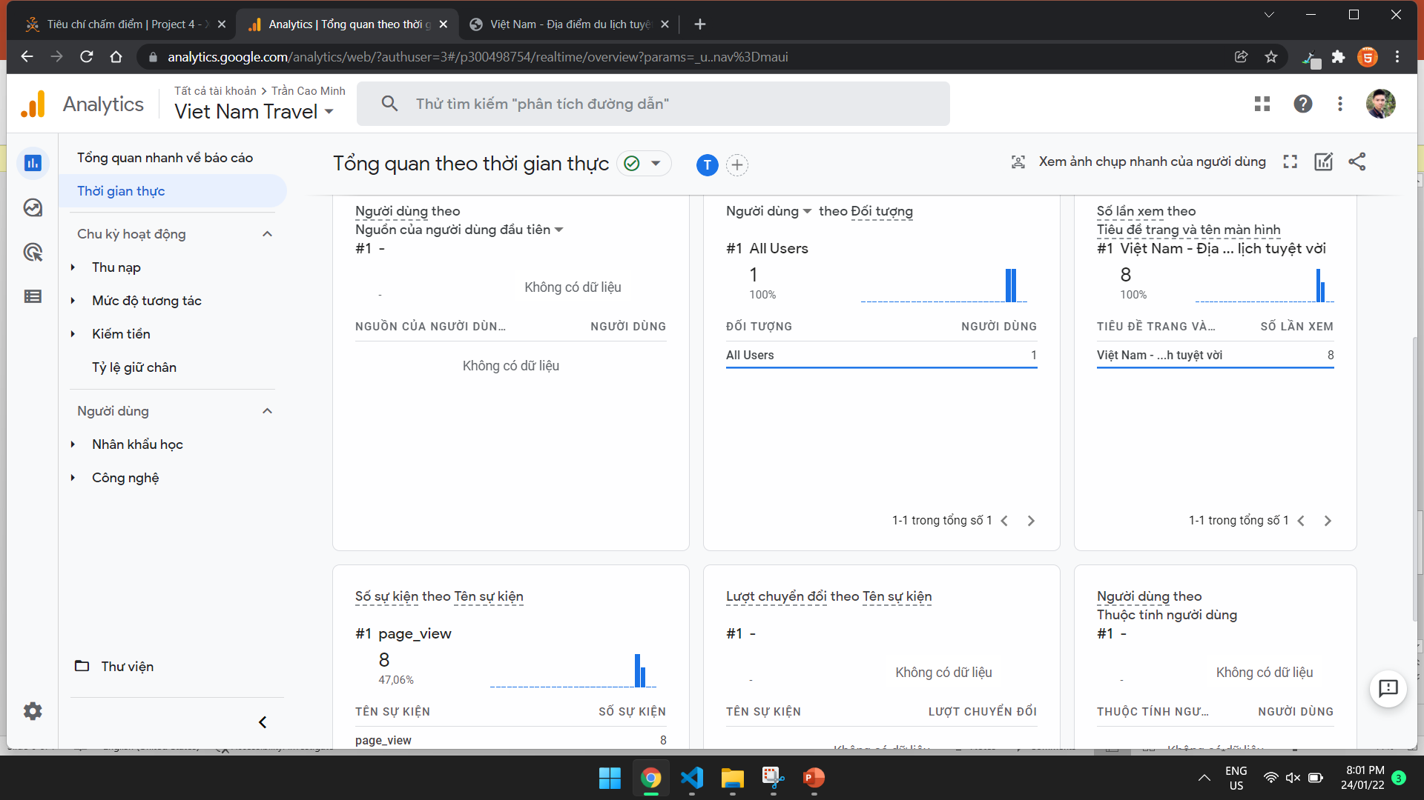

Slide 5
Gmail: minhtcfx15113@funix.edu.vn
Login
https://analytics.google.com/analytics/web/

